Slide 1
Monopolistic Competition
HS201

Slide 2
Introduction
Market structure is the focus real-world competition.
Market structure refers to the physical characteristics of the market within which firms interact.
See http://www.youtube.com/watch?v=T3F1Vt3IyNc

Slide 3
Introduction
Market structure involves the number of firms in the market and the barriers to entry.

Slide 4
Introduction
Perfect competition, with an infinite number of firms, and monopoly, with a single firm, are polar opposites.
Monopolistic competition and oligopoly lie between these two extremes.

Slide 5
Introduction
Monopolistic competition is a market structure in which there are many firms selling differentiated products.
There are few barriers to entry.

Slide 6
Introduction
Oligopoly is a market structure in which there are a few interdependent firms.
There are often significant barriers to entry.

Slide 7
Characteristics of Monopolistic Competition
Four distinguishing characteristics:
Many sellers that do not take into account rivals’ reactions
Product differentiation where the goods that are sold aren’t homogenous
*Multiple dimensions of competition make it harder to analyze a specific industry, but these methods of competition follow the same two decision rules as price competition
Ease of entry of new firms in the long run because there are no significant barriers to entry
16-<number>

Slide 8
Output, Price, and Profit of a
Monopolistic Competitor
Like a monopoly,
The monopolistic competitive firm has some monopoly power so the firm faces a downward sloping demand curve
Marginal revenue is below price
At profit maximizing output, marginal cost will be less than price
Like a perfect competitor, zero economic profits exist in the long run
16-<number>

Slide 9
What is Monopolistic Competition?
Monopolistic competition is a market structure in which:
  There are a large number of firms
  The products produced by the different firms are differentiated
  Entry and exit occur easily

Slide 10
Product Differentiation
Product differentiation implies that the products are different enough that the producing firms exercise a “mini-monopoly” over their product.
The firms compete more on product differentiation than on price.
Entering firms produce close substitutes, not an identical or standardized product.

Slide 11
Monopolistic Competition
The four distinguishing characteristics of monopolistic competition are:
  Many sellers.
  Differentiated products.
  Multiple dimensions of competition.
  Easy entry of new firms in the long run.

Slide 12
Many Sellers
When there are many sellers, they do not take into account rivals’ reactions.
The existence of many sellers makes collusion difficult.
Monopolistically competitive firms act independently.

Slide 13
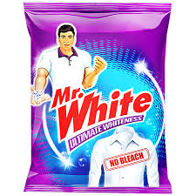
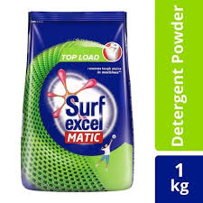
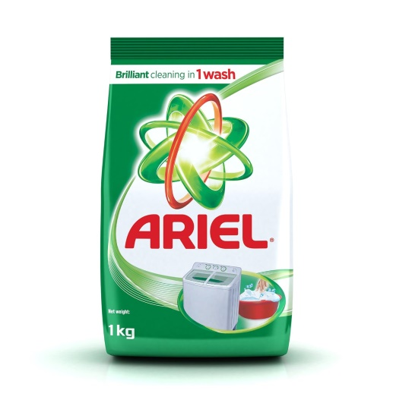
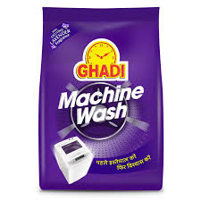
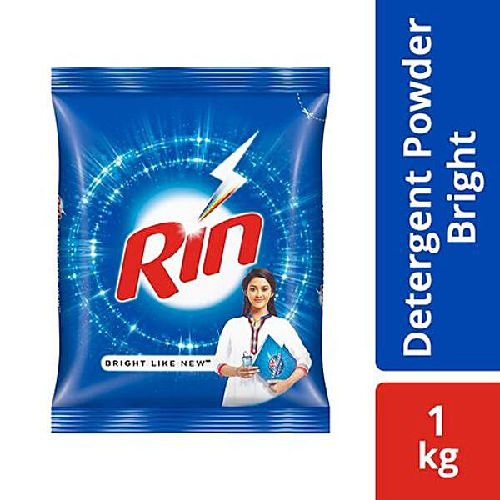
Cont…

Slide 14
Differentiated Products
The “many sellers” characteristic gives monopolistic competition its competitive aspect.
Product differentiation gives monopolistic competition its monopolistic aspect.

Slide 15

Different Models of Cars in India

Slide 16
Differentiated Products
Differentiation exists so long as advertising convinces buyers that it exists.
Firms will continue to advertise as long as the marginal benefits of advertising exceed its marginal costs.

Slide 17
Multiple Dimensions of Competition
One dimension of competition is product differentiation.
Another is competing on perceived quality.
Competitive advertising is another.
Others include service and distribution outlets.

Slide 18


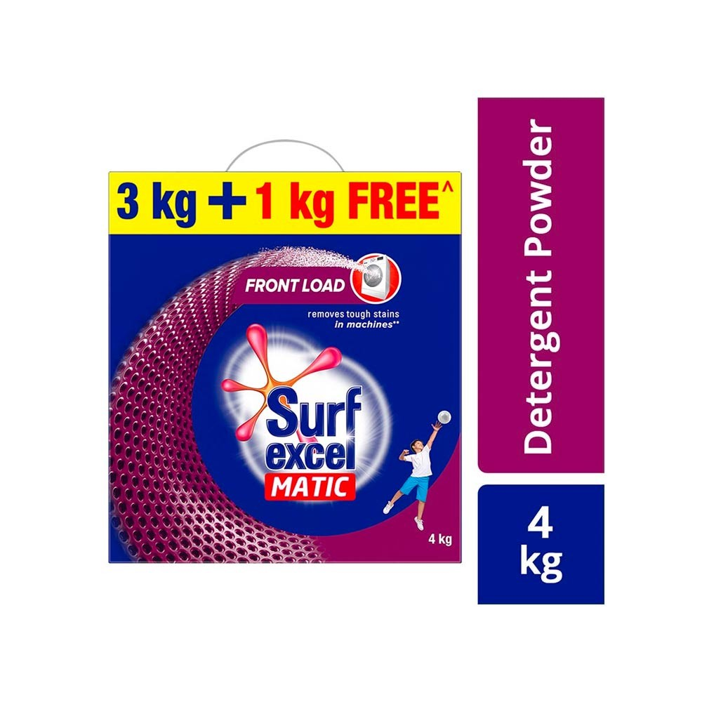
Some Illustrations of Non Price Illustration

Slide 19
Easy Entry of New Firms in the Long Run
There are no significant barriers to entry.
Barriers to entry prevent competitive pressures.
Ease of entry limits long-run profit.

Slide 20
Output, Price, and Profit of a Monopolistic Competitor
A monopolistically competitive firm prices in the same manner as a monopolist—where MC = MR.
But the monopolistic competitor is not only a monopolist but a competitor as well.

Slide 21
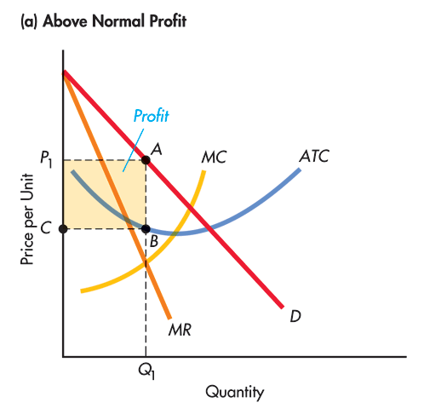
A Monopolistically
Competitive Firm: Above Normal Profit

Slide 22
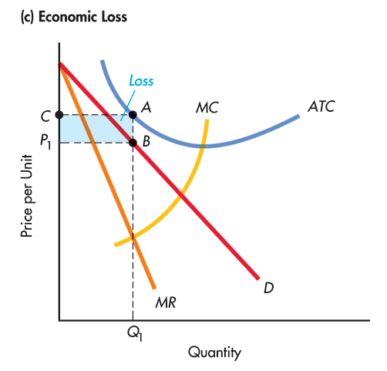
A Monopolistically
Competitive Firm: Economic Loss

Slide 23
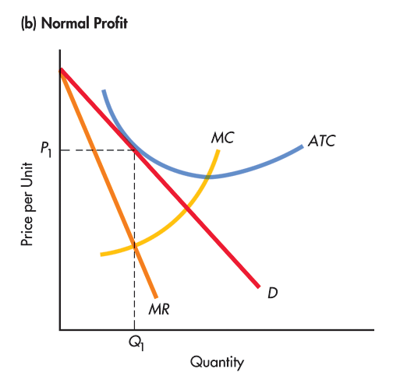
A Monopolistically
Competitive Firm: Normal Profit

Slide 24
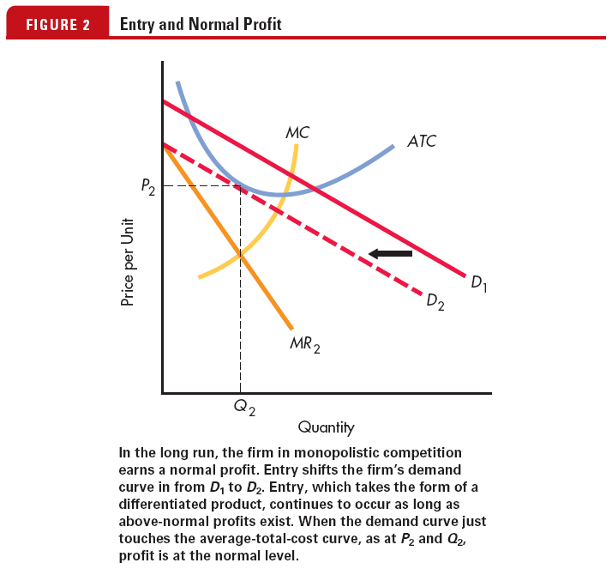
Entry and Normal Profit

Slide 25
Output, Price, and Profit of a Monopolistic Competitor
At equilibrium, ATC equals price and economic profits are zero.
This occurs at the point of tangency of the ATC and demand curve at the output chosen by the firm.

Slide 26
Monopolistic Competition
Price
MC
ATC
P_{M}
MR
D
0
Q_{M}
Quantity

Slide 27
Comparing Perfect and Monopolistic Competition
Both the monopolistic competitor and the perfect competitor make zero economic profit in the long run.

Slide 28
Comparing Monopolistic Competition with Monopoly
It is possible for the monopolist to make economic profit in the long-run.
No long-run economic profit is possible in monopolistic competition.

Slide 29
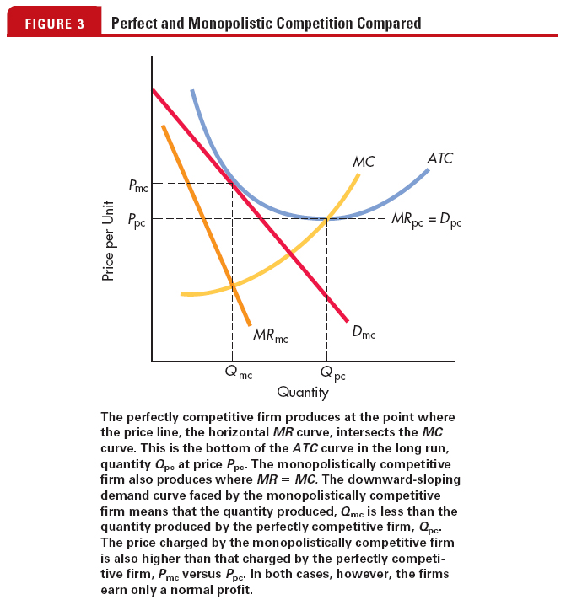
Perfect Competition and
Monopolistic Competition Compared

Slide 30
Monopolistic Competition Compared with Perfect Competition Graph
P
MC
In monopolistic competition in the long run, P > min ATC,
In perfect competition in the long run, P = min ATC
ATC
P_{MC}
P_{PC}
D_{PC}
Outcome:
Monopolistic competition output is lower and
price is higher than
perfect competition
D_{MC}
MR_{MC}
Q
Q_{MC}
Q_{PC}
16-<number>

Slide 31
Comparing Monopolistic Competition with Monopoly
It is possible for the monopolist to make economic profit in the long run because of the existence of barriers to entry
No long-run economic profit is possible in monopolistic competition because there are no significant barriers to entry
For a monopolistic competitor in long-run equilibrium, (P = ATC) ≥ (MC = MR)
16-<number>

Slide 32
Advertising and Monopolistic Competition
Perfectly competitive firms have no incentive to advertise, but monopolistic competitors do
The goals of advertising are to increase demand and make demand more inelastic
The increase in cost of a monopolistically competitive product is the cost of “differentness”
Advertising increases ATC
16-<number>

Slide 33
Nonprice Competition
The firm attempts to establish its product as a different product from that offered by its rivals.
Differentiation means that in the consumer’s mind, the product is not the same. Marketing is often the key to successful differentiation.

Slide 34
Nonprice Competition
Firms may differentiate products by perceived quality, reliability, color, style, safety features, packaging, purchase terms, warranties and guarantees, location, availability (hours of operation) or any other features.
Brand names may signal information regarding the product, reducing consumer risk.

Slide 35
Goals of Advertising
The goals of advertising include shifting the demand curve to the right and making it more inelastic.
Advertising shifts the ATC curve up.

Slide 36
Does Advertising Help or Hurt Society?
There is a sense of trust in buying brands we know.
If consumers are willing to pay for “differentness,” it’s a benefit to them.

Slide 37
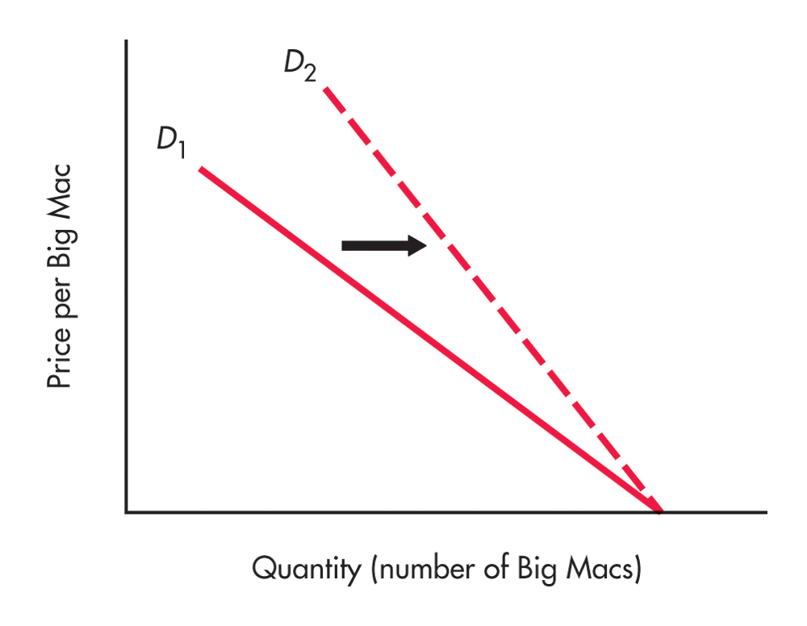
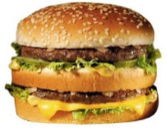
Advertising, Prices, and Profits
Product differentiation reduces the price elasticity of demand, which appears as a steeper demand curve. Successful product differentiation enables the firm to charge a higher price.

Slide 38
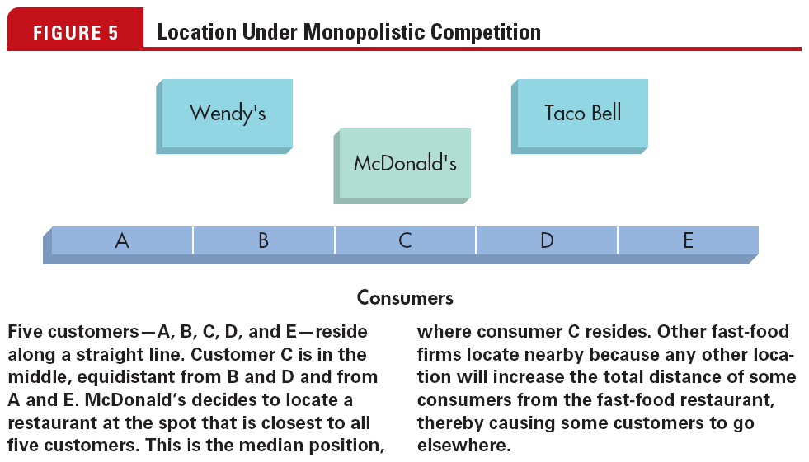
Location under
Monopolistic Competition

Slide 39
Brand Name
A brand name is valuable to a firm; it makes the demand less elastic and can enable the firm to earn higher profits.
Once a consumer has had a positive experience with a good, the price elasticity of demand for that good typically decreases—the consumer becomes loyal to the product.

